Slide 1
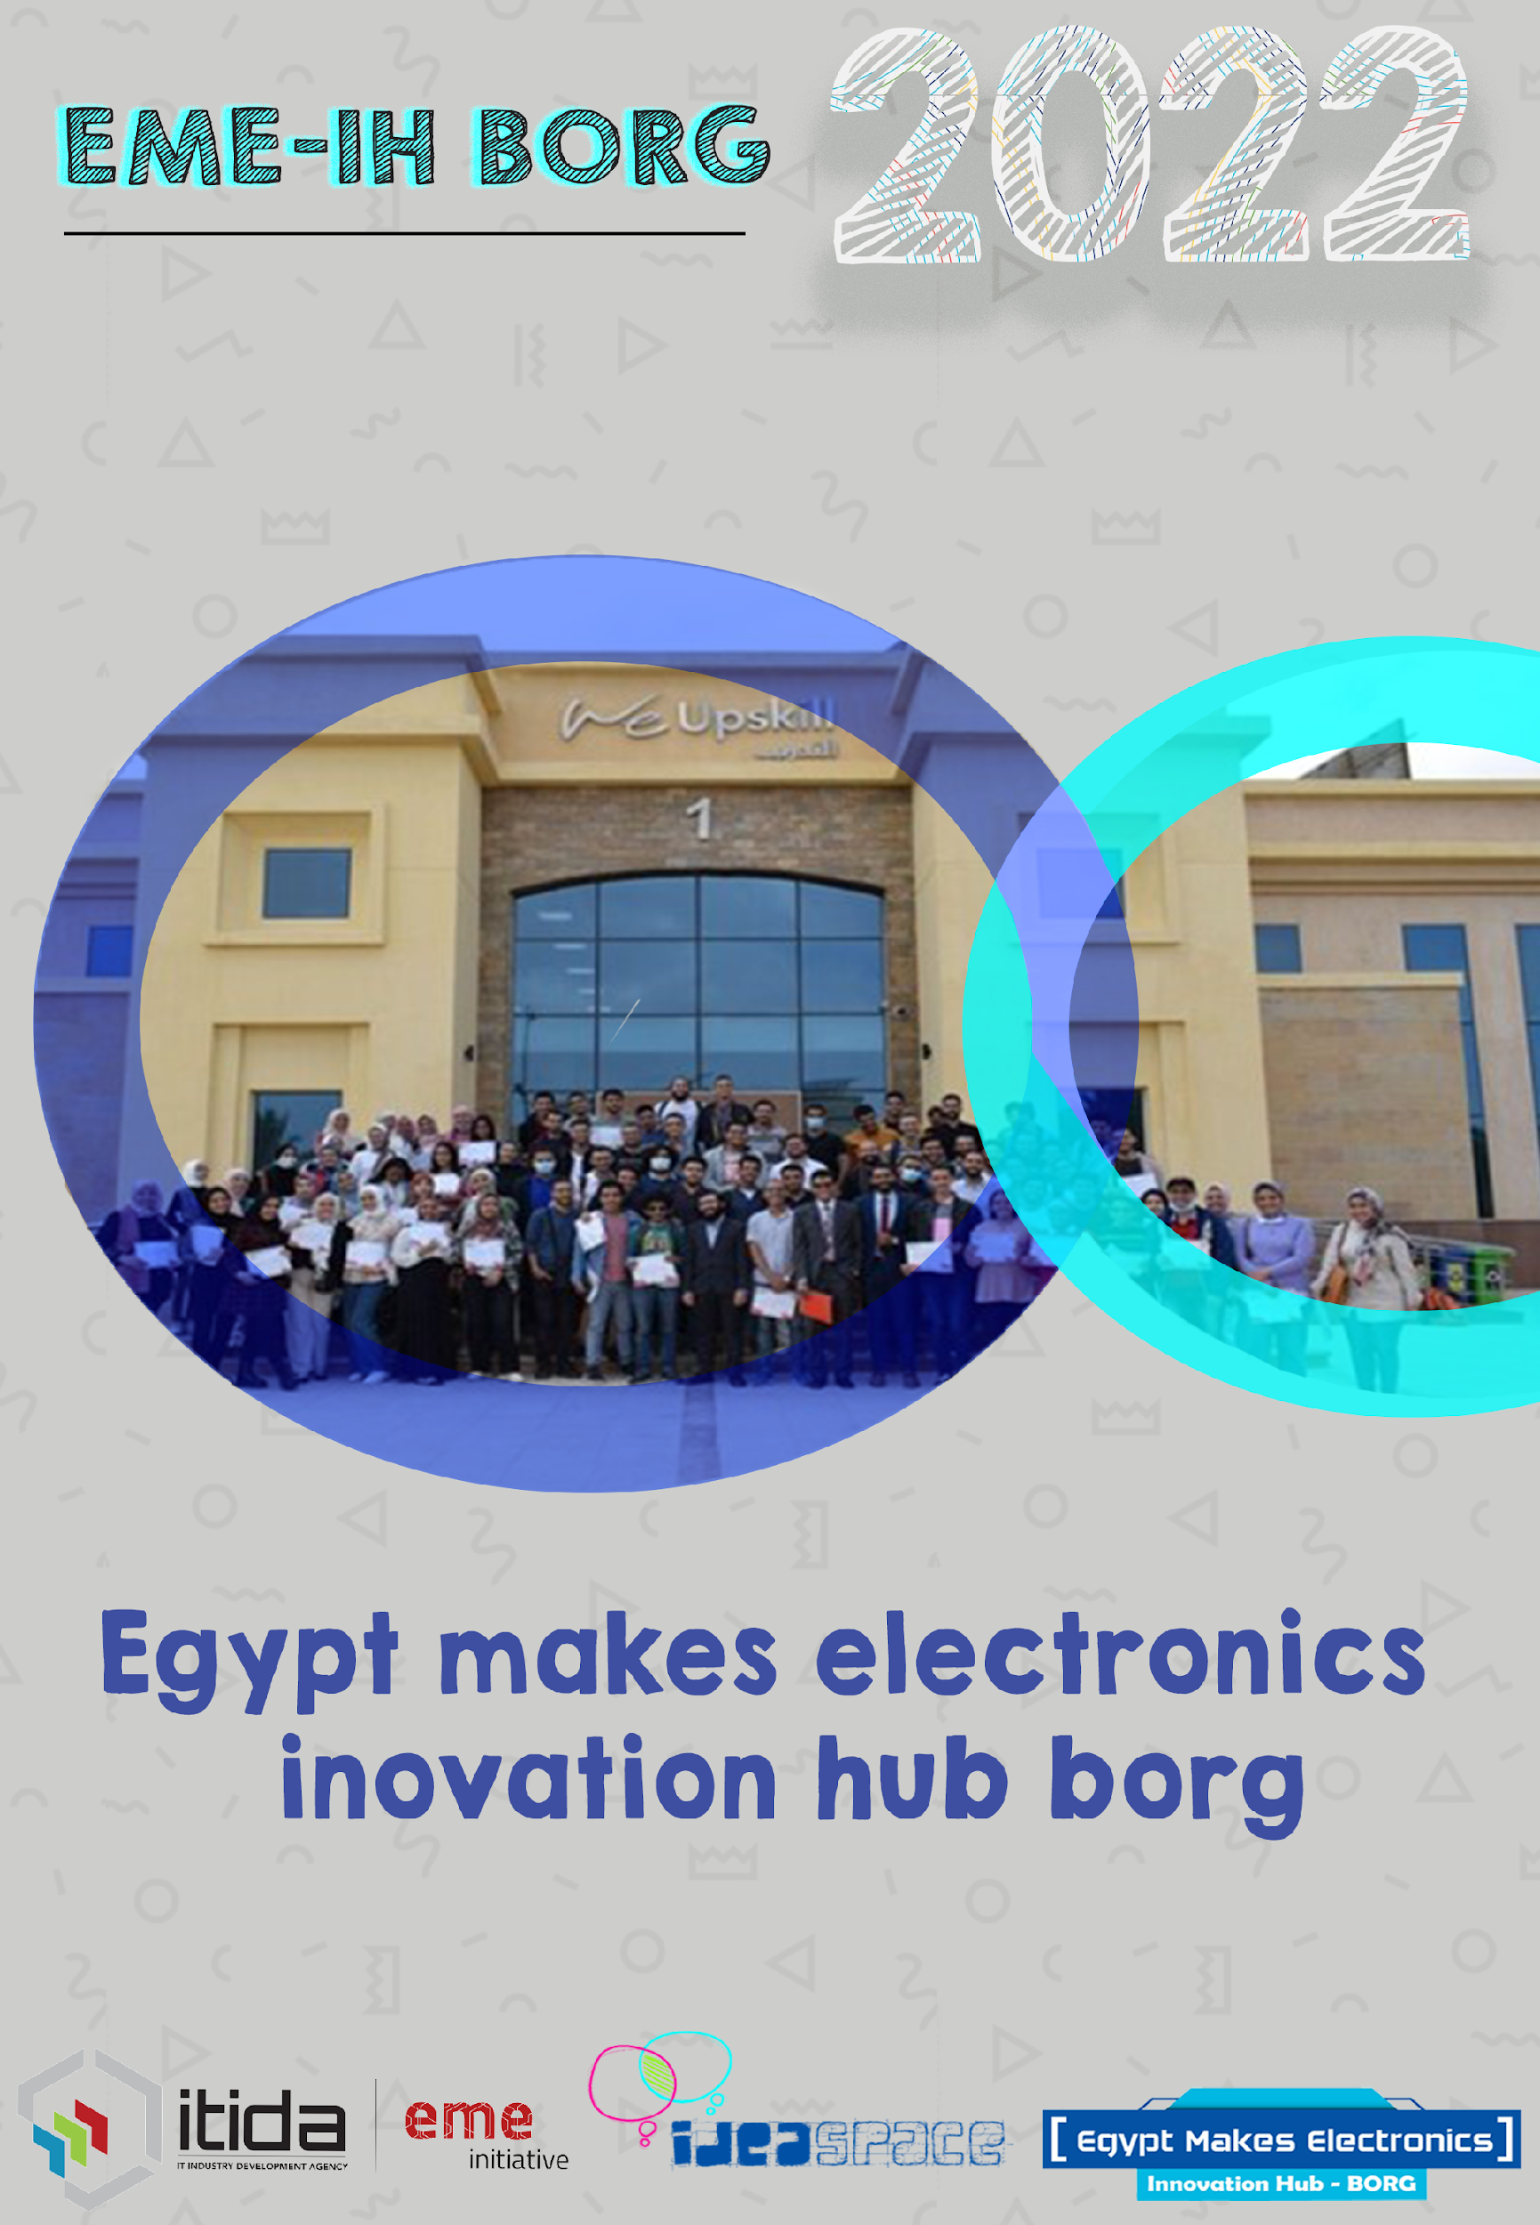

Slide 2



EME IH strategy
EME IH provides the High Tech industry with innovative solutions based on the commitment to Rigid and Flex-Rigid advanced technology and proactive customer care.
Adding engineering value early in the design cycle.
Providing innovative, cost effective and reliable solutions.
Enabling the technology edge, when needed while increasing reliability and durability.
EME IH organization
EME IH operates by bringing together innovative opportunities and developmental tools within the reach of Egyptian engineers and entrepreneurs in the ﬁelds of electronic production through collaborations with leading entities that share the same vision and general message in the market.
Vision
To Maximize the potential of the Egyptian electronics industry, create a new generation
of well informed and skilled innovators and entrepreneurs and brand Egypt as the
leading hub for innovative electronic advancements in the region.
Mission
We believe that the opportunities provided under a collective umbrella will aid in
utilizing the promising incentives in the Egyptian electronics market and contribute to
maximizing Egypt’s production in the field and the country’s global recognition

Slide 3



EME PARTNERS
ABOUT EME IH
Egypt Makes Electronics is a fully rounded project, founded by
ITIDA. The initiative aims to elevate the status of the Egyptian
electronics industry, utilize the innovative intellectual potential of
the nation and provide all the necessary means to facilitate its
development in the field as well as the country’s advancements in
the market.
And about EME Innovation Hub; provide well facilitated labs and
co-working spaces for the production of electronics, learning
opportunities for engineers, researchers and entrepreneurs in the
field, guidance and assistance for startups and promising
initiatives, a networking platform designated to the betterment of
the collective outcome and collaborative opportunities for
national contributions.
ITIDA
A governmental organization with a main focus of identifying the local IT Industry needs, providing developmental strategies, advisory services and well-designed programs. The main aim is providing the necessary services to the different initiatives whether private or public and helps the Egyptian ICT industry and its related ﬁelds to ﬂourish while maximizing its effect on the Egyptian economic growth.
Ideaspace
An innovation hub that provides labs and facilities for all stages of developing ideas, projects and products. It is designed up to an international standard to bring together a community of innovators and entrepreneurs with various skills and levels of experience. Ideaspace creates a platform for idea sharing and a networking community with industry experts and investors in a variety of ﬁelds that promotes startup business development and encourages young incentives.

Slide 4

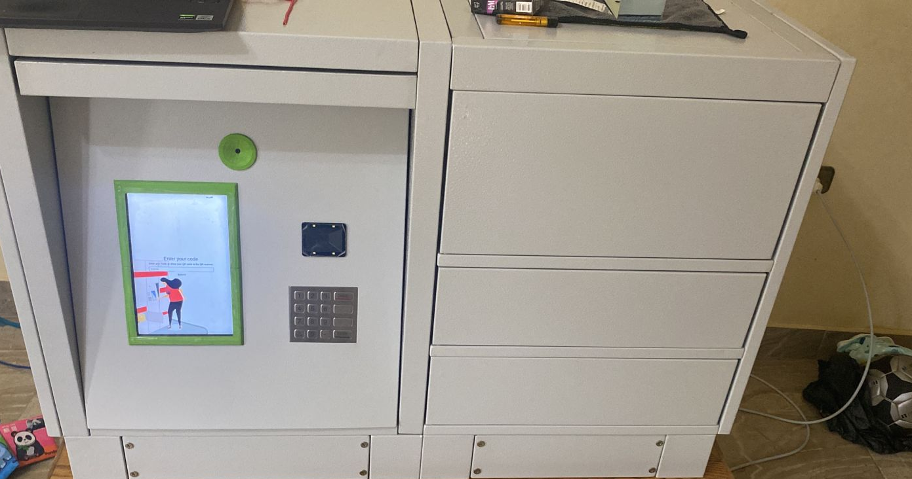
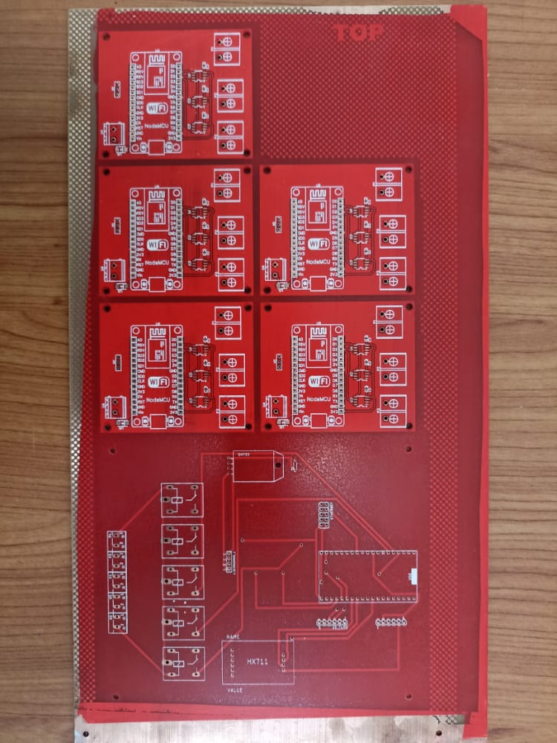
EME IH Labs ( category )
The Electronics Innovation Labs shall include 3 divisions complementing each other; first, expert IoT development lab (4G-enabled) to innovate platforms and applications in several sectors such as home consumer, transport mobility, health body, surveillance, smart energies and smart cities. IoT is a new technology wave from the evolution of embedded systems to the revolution of sustainable systems.
Digital Fabrication which comprises off-the-shelf, industrial grade fabrication and electronic tools for rapid prototyping for product mockup (metal or plastic), molds, die-casting and even pilot production using different materials.
Third, multi-layer PCB line for on-site rapid PCB circuits prototyping; fabrication and assembly.

Slide 5
Internship Program
is a project-based Learning for 3 months created and executed by ideaspace and Sponsored by ITIDA taking place in Egypt Makes Electronics Innovation Hub Borg .
Objectives:
Qualifying students and graduates through theoretical and practical courses.
Blended between Self-paced, Synchronous Learning and Guided Practices with a Project Based Focused Journey.
Offered EME IH Labs to work with startup and real industrial projects
Matchmaking between University curricula and the job Market.
How can apply ?
has a wider scope of participation that incorporate many segments from each of the hosting governorates.
ICT-Mechanical and Mechatronics related university faculty members, Graduation Projects’ teams from technical schools and universities.
The above-mentioned segment will have the priority to be accepted if they are eligible to apply
Eligibility criteria
pass from Evaluation Test
have an Idea to make a prototype as Graduation Project from Track
Ready to work with team to create final project
The number of team members – Proposed: Min. 2- Max. 7 members for GP

Slide 6


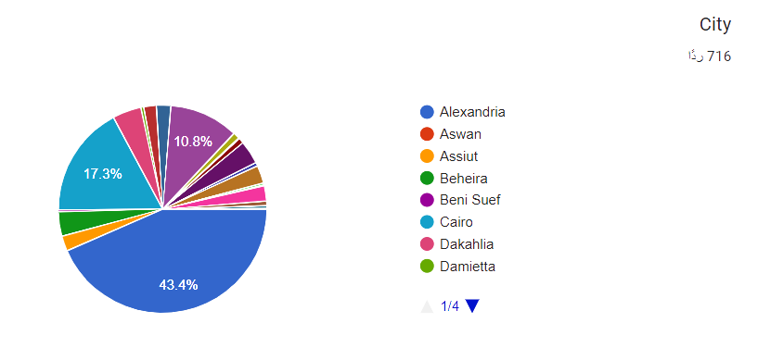
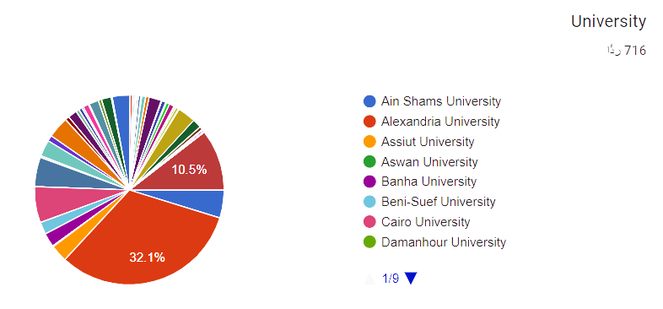
Internship Tracks
Fabrication
PCB Track
IOT and Embedded Linux
Machine Learning
Embedded System
25 Hours
25 Hours
60 Hours
50 Hours
60 Hours
Facts :
1 - More than 1000 applications submitted in June then had taken acceptance technical exam and interviews . 2 - About 150 Students at Borg had been selected from Filtration process for the 5 tracks . 3 - Requests have been received from more than 50 universities to train their students in the scholarship representatives from different universities in the opening ceremony such as E-JUST - Pharos- EELU -Alexandria university .
University
City

Slide 7
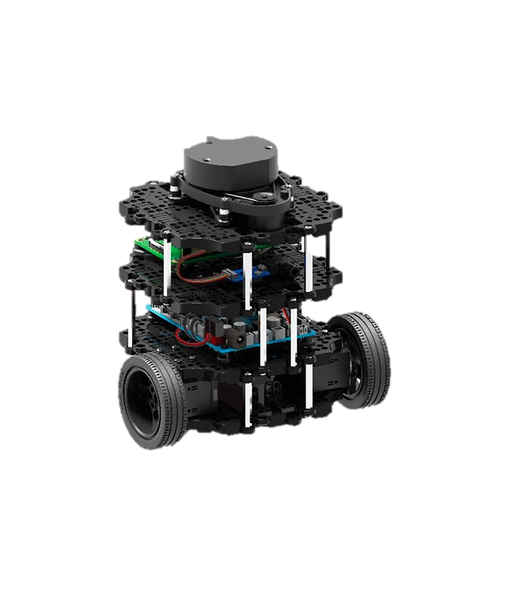

Machine Learning ( ML ) 50hrs
Self-driving vehicles are cars or trucks in which human drivers are never required to take control to safely operate the vehicle. Also, the autonomous vehicle decision on the parking spots can’t be selected randomly and avoiding obstacles also should be flexible as much as possible.
Outlines :
Learn about ML and Motion planning with respect to Autonomous Vehicle .
Dive into the Understanding of ML.
Dive into the creation of ML- Models.
Get Familiar with Linux Operating System.
Get Familiar With ROS (Robot Operating Systems).
How to embed your ML model with ROS.
Learn about motion planning.
Types of SLAM.
Deal with Nvidia Jetson-Nano.
Milestone on Hardware.
Final project :
1. Autonomous mobile robot using LIDAR sensor
2. Autonomous mobile robot using Depth Camera
3. Mobile robot obstacle avoidance or people follower using ultrasonic sensor or web camera.
Requirements :
For 1 and 2 the robot must map its environment , localize itself and navigate Autonomously given a goal point using whatever you want (voice ,text or position on the map) For 3 the robot must follow a moving person or continuously avoid obstacles in its environment.

Slide 8

Embedded Systems 60hrs
This embedded systems level one course aims to put students on the first steps of embedded systems development, it assumes no previous knowledge of the topic and will start a hands-on experience starting from Basics of C programming and AVR microcontrollers.
Outlines :
Learn to interface with different microcontrollers and their main features and differences.
design and program their own embedded systems using AVR microcontrollers by learning .
C for embedded systems.
AVR architecture.
GPIOs.
Interrupts.
Analog to Digital Converter (ADC)
Timers.
Communication Protocols (UART – I2C – SPI)
Learn how to differentiate between different code layers in embedded systems.
Final project :
Design a system that simulates a production process in a factory using the following hardware: • Two microcontrollers. • LCD • Keypad • Temperature Sensor • LDR Sensor • Fan | RC Car with door lock system mechanism: • One microcontroller. • H-Bridge and Motors • LCD. • Two LDR Sensors. • Two RGB LEDS.
More details here | More details here

Slide 9


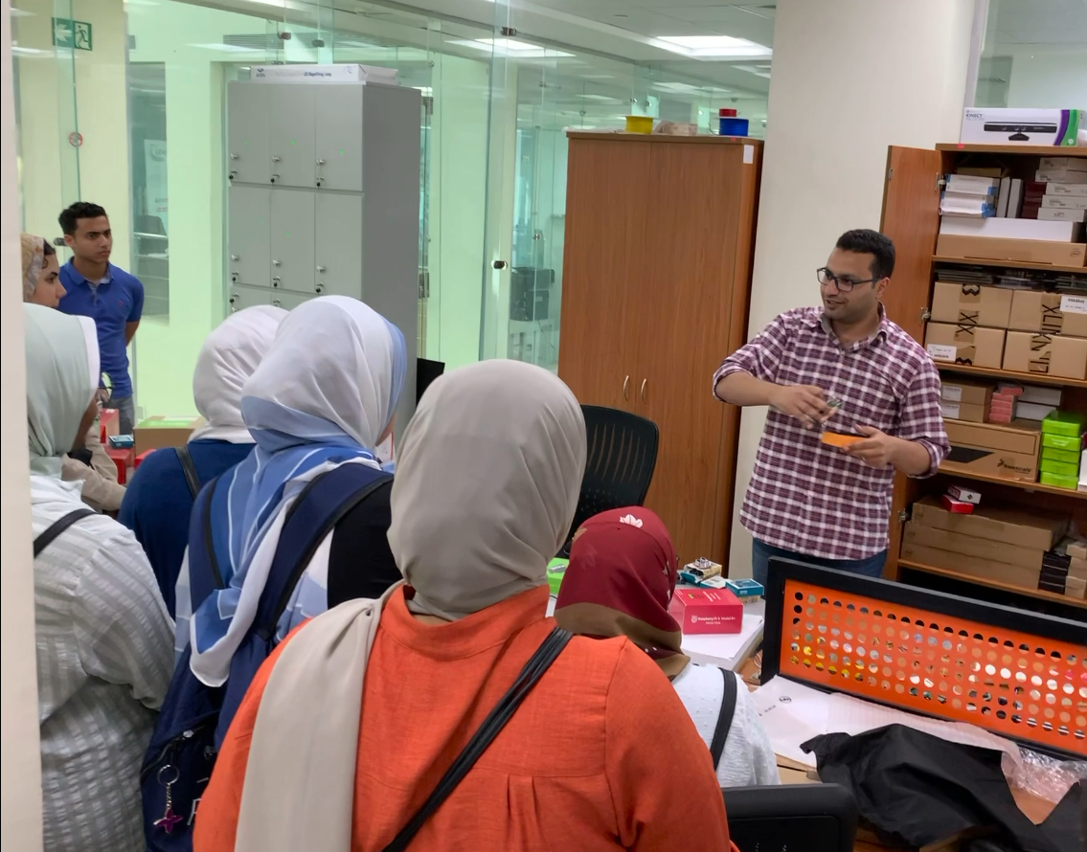
Internet Of Things ( IOT ) 60hrs
This embedded Linux and IoT course aims to put students on the first steps of Embedded Linux and IoT development, it assumes basic knowledge in python and Linux.
Outlines :
work with Linux Environment.
Design and program their own IOT on Embedded Linux machine by Learn .
Computer Network principles
Socket Programming TCP/UDP
HTTP vs MQTT
WebSocket
Introduction to Embedded Linux
Linux administration
Automation scripts
Linux main components
Buildroot
Yocto
Integrate IoT with Embedded Linux.
Final project :
● Home automation controlled via web application ● Monitoring and controlling Industry

Slide 10
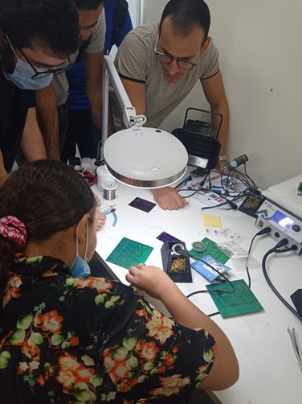


Printed Circuit Board ( PCB ) 25hrs
This course is designed to improve the skills of the PCB designer who has a basic understanding of the PCB design and fabrication process by going into greater detail and assisting him in learning important tips and tricks as well as advanced design methodology. This course also aims to teach students soldering techniques, particularly for SMD components.
Outlines :
From idea to schematic process (DFM)
Components selection and documentation review
Design a schematic for multifunction board
Layout design and advanced tips and tricks
Generating manufacturing files
Fabrication process (hand-on experience)
Soldering process, techniques and tools (hand-on experience)
Board testing using electronics workbench tools
Final project :
The instructor will show the students each session a step in the design process, by the end of the course the design process will have been fully covered.
This project aims to determine the level of applicants in: - Creating components packages - PCB Schematic design - PCB Layout design

Slide 11
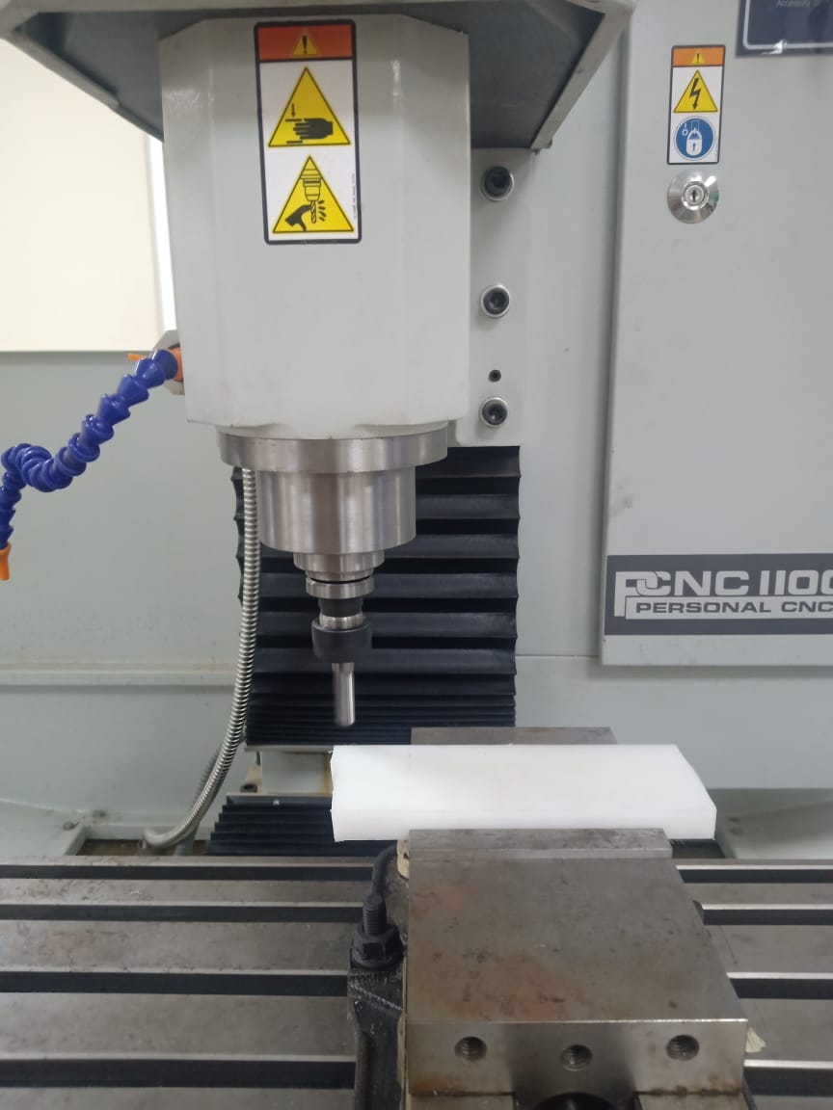

Fabrication 25hrs
The course is to explain what is milling and types of machines, its processes and methods, and to learn about CNC machines and ways to program them. The use of the powermill program is also fulfilled to an advanced level.
Outlines :
Introduction to milling
Types of milling machines
Operations and methods of milling
Different between CNC machines and others
The way to program the CNC
POWERMILL
Final project :
Make a program for drone feathers stamp For the purpose of mass production
The student made the Gcode himself using the powermill program and then manufactured it himself on a CNC milling machine

Slide 12
Closing Day
Place, Audience and Date :
Place : Engineers Syndicate - Alexandria
Audience : 150 - 170
Date : After Finishing all programs
Time : 4 hours
Contact Information :
Ahmed Alaa
-Role-ITIDA Director EME Borg
Phone Number: 01090441449
Email: aalaa@itida.gov,eg
Mahmoud Ragab
-Role- Community Manger EME IH Borg
Phone Number: 01020360891
Email: mahmoud.raagb@ideaspace.xyz

